Slide 1
Engage Students with Technology
By: Trevor Moore

Slide 2
Project Goal
My overall goal for this project is to get teachers to realize that it is beneficial to integrate the use of technology into their classrooms.

Slide 3
Design Descriptions
The first design is a flyer that would be posted in the school. It would capture the attention of the teachers in the school and let them know when the presentation would be and where it would take place.
The second design is the first slide of a PowerPoint presentation that I would give on why it is important to integrate the use of technology into their classrooms.
The third design is an interpretive sign that describes why it is so important that technology is integrated into the classroom.

Slide 4
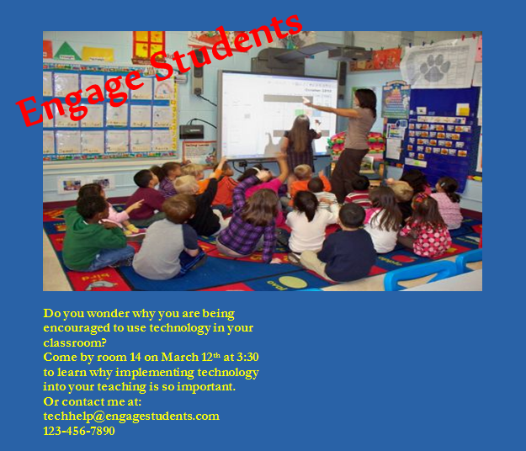
Flyer

Slide 5
Flyer Description
For the flyer I placed a picture of a teacher using a SmartBoard during a lesson and a class of students who are fully engaged in the lesson.
I placed the title at an angle so that it created contrast with the rest of the text as well as grab the viewer’s attention.
The text under the picture describes what the presentation will be about, where it will be and when it will be.
I made the background blue so that it would recede from the eye and so that the red and yellow text would stand out.

Slide 6
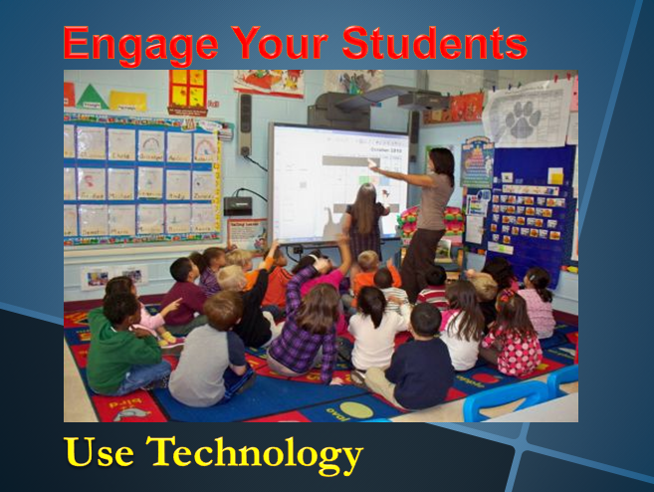
PowerPoint Slide

Slide 7
PowerPoint Slide Description
For the opening PowerPoint slide I used the same picture as I used on the flyer to create repetition and so that it was recognizable.
I also used the same title as I used on the flyer and had it be the same color. I made the caption be the same color as the text on the flyer. I used the same colors PowerPoint slide as I did on the flyer to create repetition between the designs and because red, yellow and blue work well together and are visually appealing.

Slide 8
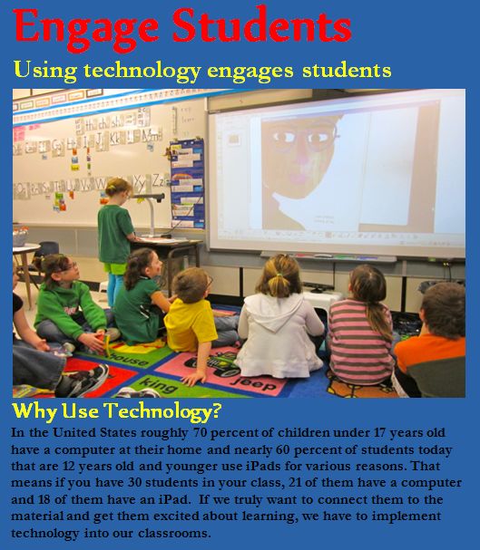
Interpretive Sign

Slide 9
Interpretive Design Description
For the interpretive sign I decided to use a different picture to create a somewhat different look from the other designs.
I used the same title as the other two designs to show that they are all connected.
I also made sure that the three designs are connected by using the same color scheme. I made the title red, and the text yellow so that they would stand out from the blue background.

